Slide 1
RFIC Interactive Forum (IF)
PowerPoint Presentation Template

Slide 2
IF PowerPoint Presentation
Your Interactive Forum (IF) presentations at RFIC 2018 will consist of two parts:
A printed “Poster” affixed to a “Poster Board”, aka meter-board
A PDF or PowerPoint presentation on a 55” monitor, using the provided computer
This guideline is for the second part, the PowerPoint presentation (see highlighted section below)
A single, printed summary poster discussing the participant’s research in broad strokes. This poster will be in the form of a “Penta” chart, which covers the primary motivations, insights, and results of the project. Participants are responsible for preparing, printing, and bringing their poster to their specific IF session.
A short set of PowerPoint slides that will be displayed on a 55” monitor. These slides will be tied to subject areas displayed on the Penta chart, and will allow participants to discuss their methods, results, and conclusions in more detail with forum attendees.
IMPORTANT NOTE:
IF Presenters MUST check in with the Session Chair(s) at the Check-In Area (see map on slide 14) at least 15 minutes prior to the start of their session.

Slide 3
IF PowerPoint (or PDF) Presentation
RFIC2018 will provide each IF Presenter the option to provide additional details of their work, as a PowerPoint or PDF presentation, on a 55” monitor using a computer. The monitor and computer are made available at each IF station.
This PowerPoint document is the mandatory RFIC2018 IF Presentation template and includes all necessary logos and banners. The presentation must be prepared in landscape with an aspect ratio of 16:9.
The PowerPoint (or PDF) slides should refer to the five sections of the Penta chart; this reference should be included on the left-hand side of each slide (see examples in the following slides of this template). The presenter/author can use the slides to provide detailed information about his or her research.
IMPORTANT NOTE: RFIC intends to make the IF presentations available to the conference attendees as PDF down-loads, a week after and up to 60 days from the conclusion of the IMS Microwave Week. However, the down-loadable presentations are restricted to only those that have the necessary permissions and authorizations from the presenter/author(s) institutions and sponsors for such dissemination. The presenter/author(s) are SOLELY responsible to seek and secure such permissions and authorization prior to the final submission on Monday, 28 May 2018. This includes securing, as applicable, all ITAR and other governmental permissions. The IEEE, MTT-S, and/or RFIC2018 will neither assume nor bear ANY responsibility for materials submitted without appropriate approvals or clearances, and will make NO attempt to retract, rescind, or redact the submitted materials.
Please refer to the detailed instructions at the RFIC website on the preparation and submission of the IF presentations.

Slide 4
Example
Paper Title
Author 1, Author 2
University of XYZ

Slide 5
Paper title
Example
Prior approach – 1
Provides excellent performance metric ABC (e.g., efficiency)
Requires high supply voltage and multiple external components
Block Diagram/Architecture of prior approach 1
STATUS QUO AND DESIGN GOALS
Prior approach – 2
Provides excellent performance metric DEF (e.g., ACPR)
Sensitive to matching between components, multiple tuning elements etc..
Block Diagram/Architecture of prior approach 2
Note: Provide a summary of the prior approaches related to the paper. Identify benefits and disadvantages

Slide 6
Paper title
Example
A XYZ (e.g., transmitter) is proposed for the purpose of
Maximizing efficiency
Designing for high Peak-to-Average-Power (PAPR) signals
etc …
STATUS QUO AND DESIGN GOALS
Note: State what the high-level architecture is (e.g., transmitter/receiver etc), for what application and outline the goals of the design – what are the issues in prior approaches that are being addressed

Slide 7
Paper title
Example
HIGH-LEVEL BLOCK DIAGRAM (CONCEPT)
NEW INSIGHTS
An approach that solves key design challenge ABC is introduced which employs
Technique – 1
Technique – 2 etc.
Note: Identify the new approach and highlight key features. Provide a high-level diagram of the approach.

Slide 8
Paper Title
DIAGRAM(s) OF COMPLETE ARCHITECTURE
Example
Critical sub-designs/blocks (e. g.)
Sub-design 1
Sub-design 1 consists of …
Sub-design 2
Sub-design 2 consists of ..
…
DESCRIPTION
Note: Identify critical blocks in the architecture and provide a detailed architecture diagram that shows the interaction between these blocks

Slide 9
Paper Title
DIAGRAM OF SUB-DESIGN 1
Example
Critical sub-design 1
Circuit-level description
DESCRIPTION
Note: Describe the critical sub-designs/blocks

Slide 10
Paper Title
Example
Important measurement
1
Important measurement
2
QUANTITATIVE IMPACT
Note: Show important measurements here. Provide key results that validate stated design goals.

Slide 11
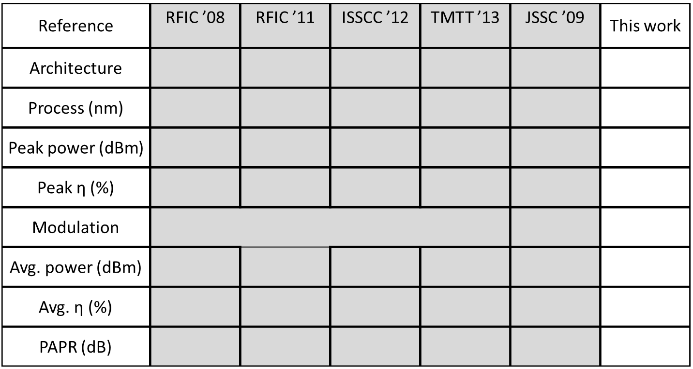
Paper Title
Example
QUANTITATIVE IMPACT
Note: Include comparison table (Identify critical and relevant parameters).

Slide 12
Paper Title
Example
DIE PHOTO
TEST BOARD/MEASUREMENT SET-UP
DESIGN SUMMARY AND CONCLUSION
Note: Show physical set-up (e.g., die photo, test set-up etc).

Slide 13
Paper Title
Example
An XYZ is desribed
Feature 1 (eg., high efficiency/low noise figure etc ) is demonstrated
….
Future goals and potential enhancements
(e.g.) migrate approach to higher frequencies etc.
DESIGN SUMMARY AND CONCLUSION
Note: Summarize clearly what was achieved or demonstrated in the work. Describe future directions, if relevant.

Slide 14
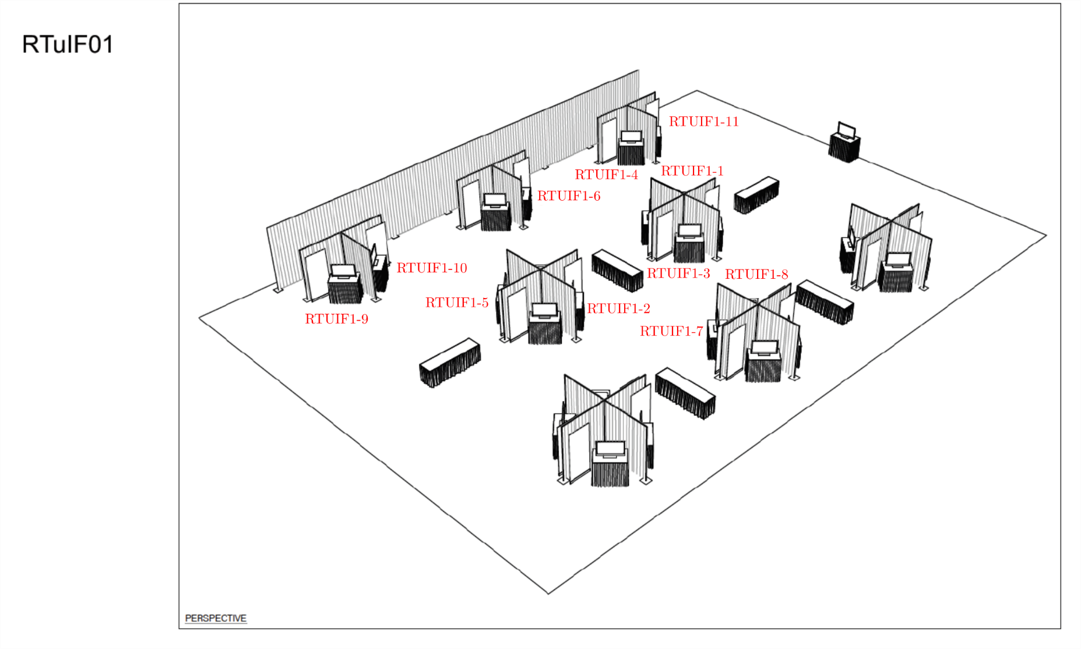
RFIC Interactive Forum Layout
IMPORTANT NOTE: Presenters must check in, at the Check-In Area, at least 15 minutes prior to the start of their session.

